Slide 1
FHIR Implementation Guide Creation Training
September 11-12, 2019

Slide 2
Your FHIR IG Tutorial Team
Nagesh (Dragon) Bashyam
Senior Architect and Advisor for Drajer LLC having worked on FHIR, C-CDA, and QRDA I&III. Created many FHIR IGs including US-Core and DAF-Research.
Sarah Gaunt
Senior Information Analyst with Lantana Consulting Group, involved with HL7 standards since 2006, in the UK, Australia, and USA. Have authored many, many CDA IGs and several FHIR IGs.
David Pyke
Jack of all trades for Ready Computing, CBCP co-chair, trained facilitator and project manager, FHIR IG writer and resource owner

Slide 3
Your FHIR IG Tutorial Team
Lloyd McKenzie
Senior consultant w/ Gevity. Author of 15+ FHIR IGs and committer for the IG Publisher. Have been doing healthcare IT for 20 years and involved w/ FHIR since before it was FHIR.
Melva Peters
Co-Chair of the Pharmacy Work Group, International Council and Clinical Steering Division, Technical Steering Committee (TSC) and is the Secretary of the HL7 Board. FHIR Implementation Guide Facilitator for HL7.

Slide 4
Agenda
Wednesday:
What is an IG?
Profiling
Discuss questions from videos
Hand-authoring using XML
Hands-on exercises
Managing, Debugging and QA

Slide 5
Agenda
Thursday:
Working the HL7 process
Community Building
Source Control
Vocabulary Overview
FHIR IG Structure and Organization
Quality
Open discussion

Slide 6
What is a FHIR Implementation Guide?
“An implementation guide (IG) is a set of rules about how FHIR resources are used (or should be used) to solve a particular problem, with associated documentation to support and clarify the usage.”
A set of constraints on FHIR resources, value sets and supporting information to solve a use case. It may also include customized operations.
Why do we need them?
“The [FHIR] specification focuses on defining capabilities and creating an ecosystem. National standards, vendor consortiums, clinical societies, etc. publish "implementation guides" that define how the capabilities defined by the FHIR specification are used in particular data exchanges, or to solve particular problems.”

Slide 7
What is a FHIR Implementation Guide
Implementation Guides contain two different types of resource references:
Contents: A set of logical statements which implementations must conform to. These are almost always conformance resources such as Resource Profiles and Value Sets/Code Systems
Examples: Examples that illustrate the intent of the profiles defined in the implementation guide. These can be any kind of resource
An application's Capability Statement may identify one or more implementation guides that an application conforms to.
They will also have prose, graphics and logical models to help the Implementer and user of the IG

Slide 8
Fhir Profiling
Building an Implementation Guide

Slide 9
Questions?
FHIR Videos

Slide 10
Trifolia
Tools for IGs

Slide 11
Trifolia-on-FHR: Overview of Tool
Trifolia-on-FHIR
Web-based tool
Back end is FHIR servers (HAPI)
Supports multiple servers and version of FHIR
Integrated with the HL7 FHIR IG Publisher

Slide 12
Trifolia-on-FHIR: Main Functions
Create and edit an ImplementationGuide
Create and edit profiles and extensions (StructureDefinition)
Add resources to an ImplementationGuide
Create and edit the pages and narrative content of an IG
Publish the IG (using the HL7 IG Publisher)
Run the FHIR IG Publisher right in ToF
View the resulting IG
QA and validate
Export all files needed to publish the IG elsewhere (like the FHIR CI build)

Slide 13
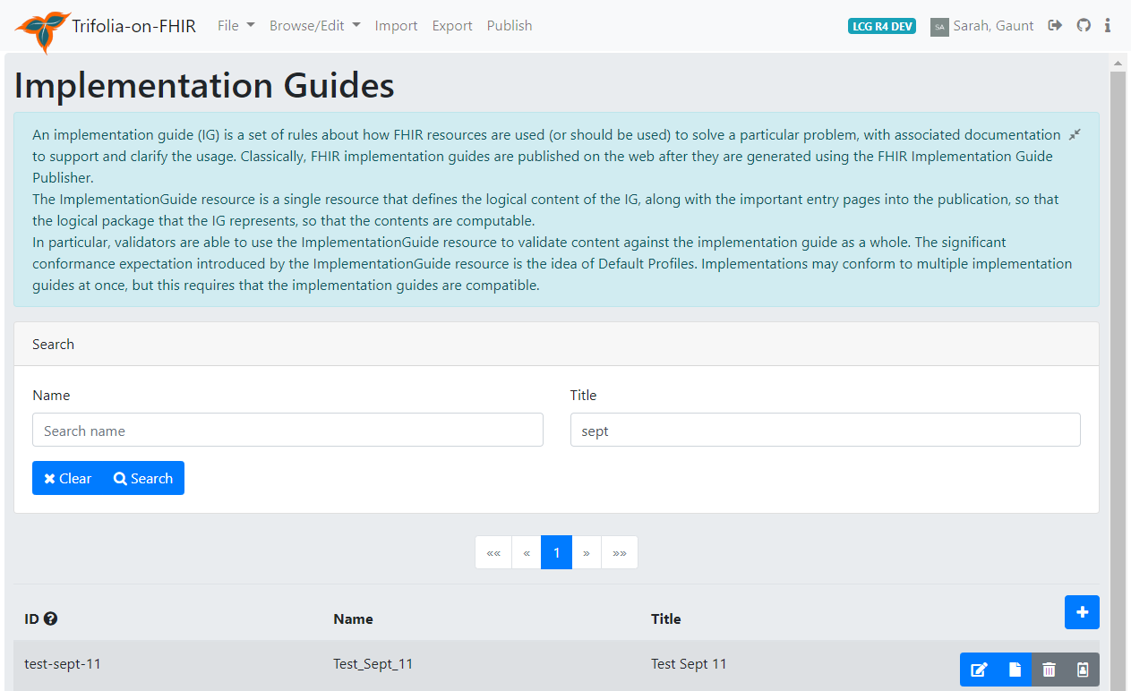
Browse Implementation Guides
Search for an IG by name or title
Edit IG
View published IG
Delete IG
Change ID
Add/create new IG
1
6
1
3
4
5

Slide 14
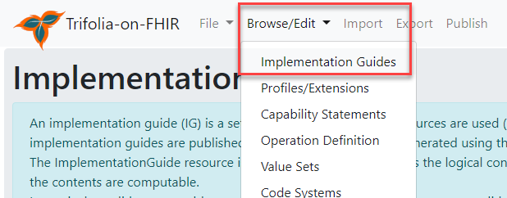
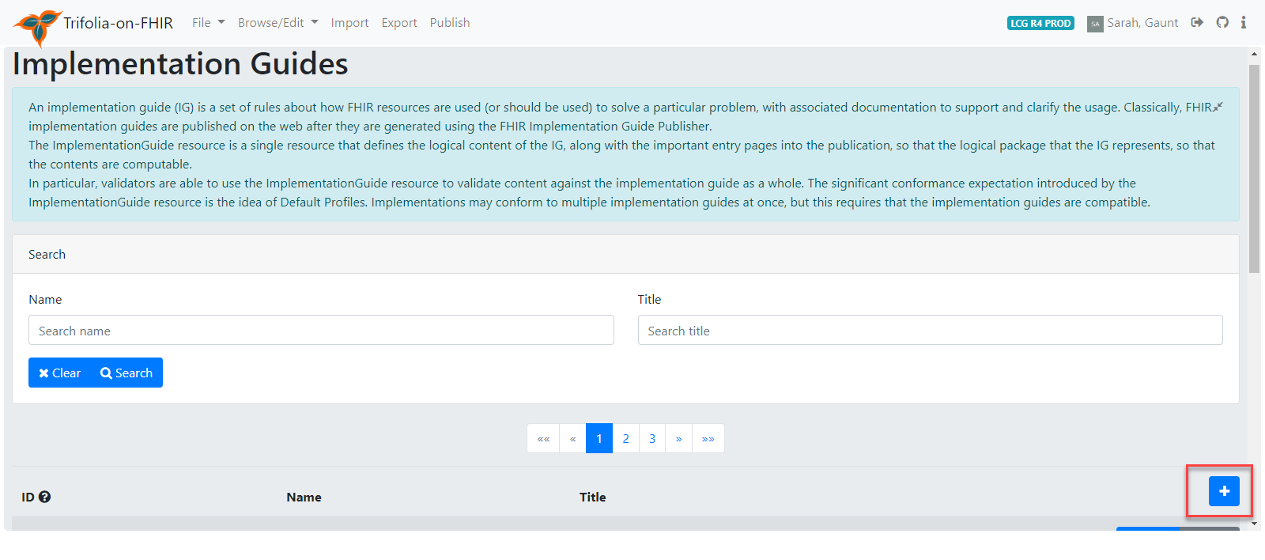
Creating an Implementation Guide
Browse/Edit Implementation Guides
Click on + icon

Slide 15
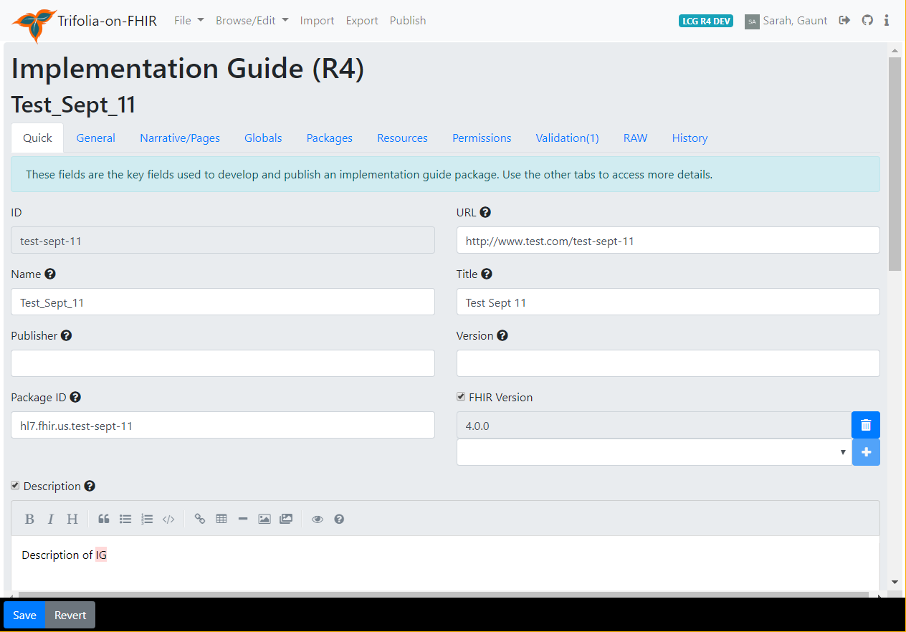
Creating an Implementation Guide
Browse/Edit Implementation Guides
Click on + icon
On Quick tab
Add the IG canonical url
Add the IG name
Add the package ID
Set the FHIR version (click +)
Add description
Add dependencies
Add more metadata on the General tab
SAVE

Slide 16
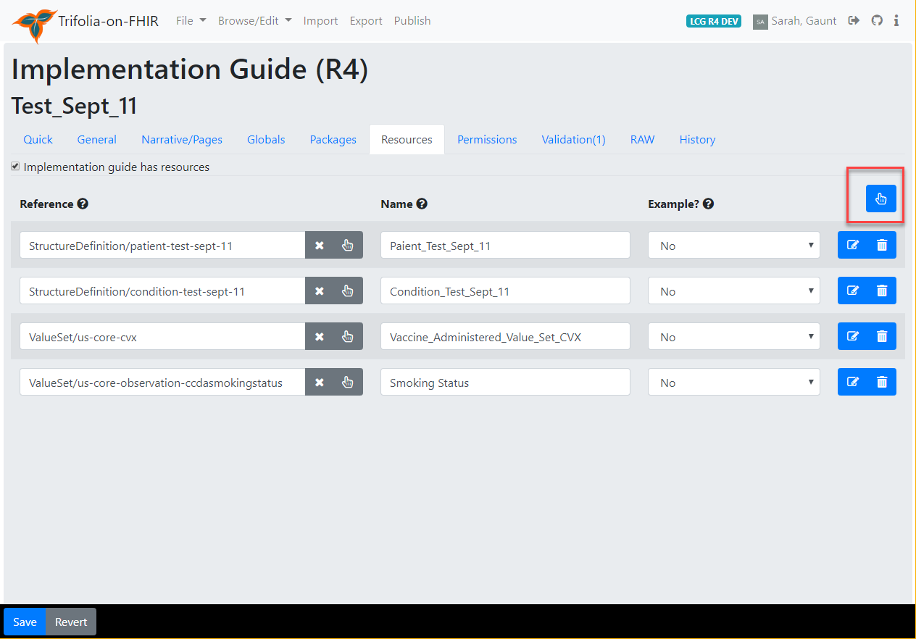
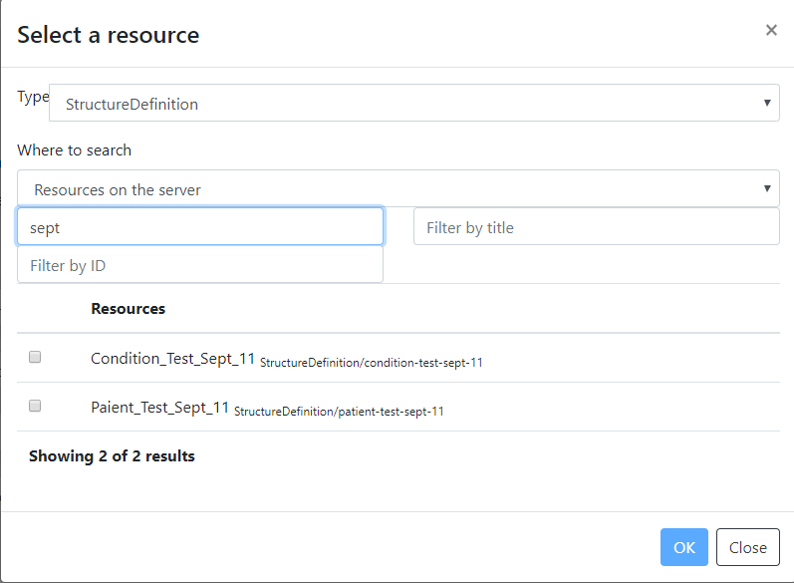
Adding IG Resources

Slide 17
Additional Actions
Adding pages
Creating and editing profiles
Creating and editing terminology
Importing files
Publishing/Exporting

Slide 18
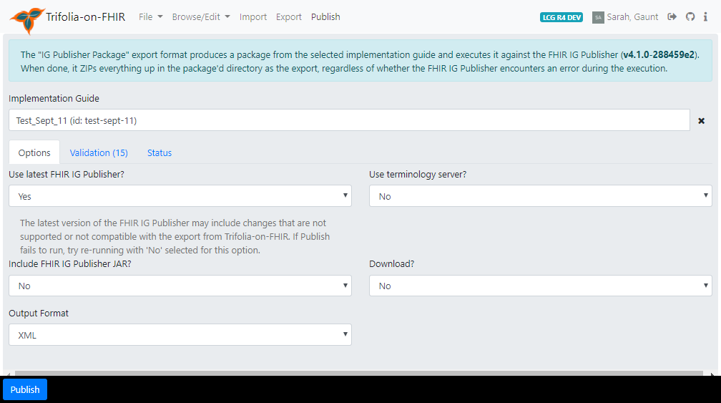
Publish IG
Select IG
Use most recent IG Publisher
Use terminology server
Include IG Publisher JAR in download (if downloading)
Download IG (for local/CI build)
Output of download (JSON or XML)
1
2
3
4
5
6

Slide 19
Forge
Tools for IGs

Slide 20
Using Forge
Pros:
Updated directly on launch
Fully compliant with DSTU2 - R4 (separate downloads)
Imports into Simplifier.Net and directly to a FHIR server
Edit direct on your local system (not a web application)
Cons:
Creates Sparse Differentials
Must have local copy of dependent profiles in subdirectory
Currently doesn’t allow underscores in name (which is legal)

Slide 21
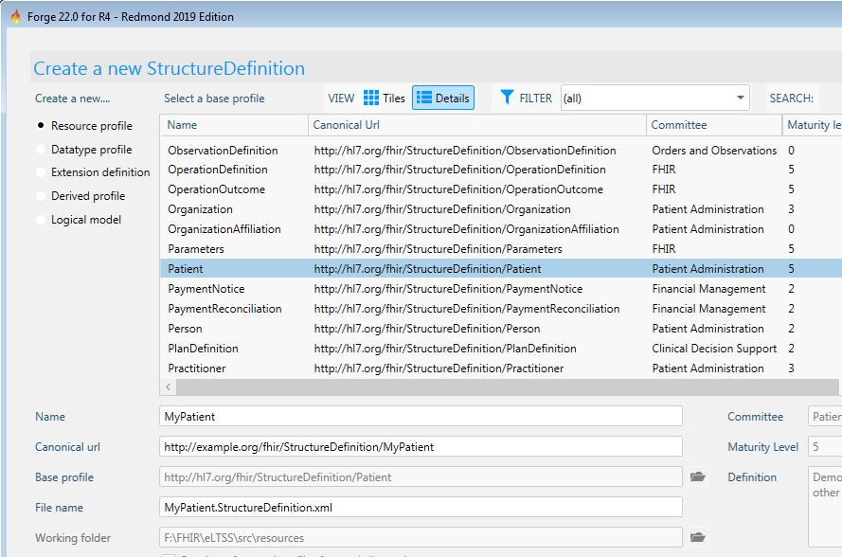
Using Forge
Select your base resource or profile

Slide 22
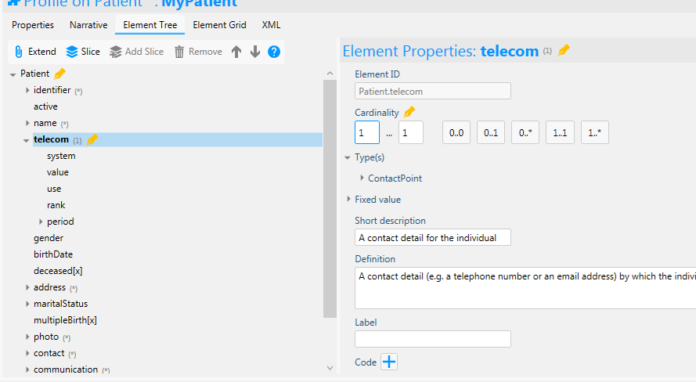
Using Forge
Modify the constraints

Slide 23
Spreadsheets
Tools for IGs

Slide 24
XML Editing
Tools for IGs

Slide 25
FHIR IG XML Authoring
Project Template to be used for excercises
https://github.com/HL7/sdc
https://github.com/FHIR/sample-ig
Clone the project in your favorite IDE.
Download the IG publisher tool
Java –jar org.hl7.fhir.publisher.jar –ig ig.ini

Slide 26
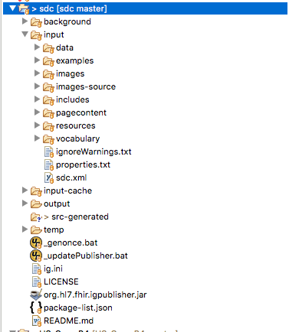
FHIR IG – XML Authoring
Specifically
examples
Example files go here
images
Image files go here
pagecontent
Narrative content goes here
resources
Profiles go here
vocabulary
CodeSystems and ValueSets go here
Project Structure
Ig.xml

Slide 27
XML Authoring – ig.ini
Master file that is used by the tool to start creating the rest of the content
Typically short and points to an Ig.xml (Implementation Guide Resource) , In this example – sdc.xml
[IG]
ig = input/sdc.xml
template = hl7.fhir.template
usage-stats-opt-out = false
copyrightyear = 2015+
license = CC0-1.0
version = 2.8.0
ballotstatus = CI Build
fhirspec = http://build.fhir.org/
#excludexml = Yes
#excludejson = Yes
excludettl = Yes
excludeMaps = Yes

Slide 28
XML Authoring – ig.xml
Implementation Guide Resource
Contains Metadata about the IG (name, package Id, URL, fhir version etc)
Identifies the various artifacts that have to be processed
Profiles
CodeSystems
ValueSets
Extensions
OperationDefinitions, Search Parameters
Examples

Slide 29
Exercise: ig.xml Review
Open the project
Open SDC IG
http://build.fhir.org/ig/HL7/sdc/index.html
Review sdc.xml and ask questions
Compare the sdc.xml with Implementation Guide resource
http://hl7.org/fhir/implementationguide.html

Slide 30
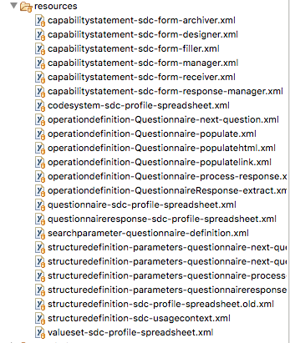
XML Authoring - profiles
These XML files are best edited using spreadsheets
Note: CodeSystem and ValueSet XML files present here are actually profiles of resources and not instances

Slide 31
Exercise: Profile Review
Open the SDC project
Open questionnaire-sdc-profile-spreadsheet.xml
Take a look at sdc-questionnaire tab and ask specific questions

Slide 32
Exercise: Add A Profile And Publish
Open the project
Create a profile of questionnaire (new one) using questionnaire-sdc-spreadsheet.xml as an example
Copy sdc-questionnaire tab contents into another tab and specify your profile (say sdc-test-questionnaire)
Change cardinality, remove some elements
Add the profile to sdc.xml
Publish the IG and view the profile show up locally

Slide 33
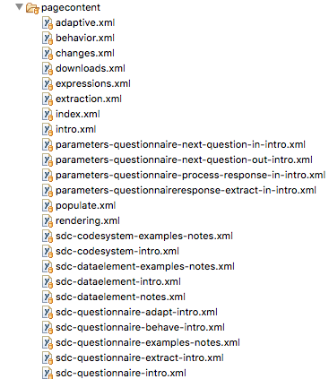
XML Authoring – Page Content
Exercise:
These XML files are best edited using XML Editor
Change the content of index.xml, sdc-questionnaire-intro.xml and sdc-questionnaire-notes.xml
- Add a paragraph with 2 lines each
Publish the change and review the change locally

Slide 34
Profile Building – Hands On

Slide 35
Profiling Purpose
FHIR resources
Most data elements optional
Terminology isn’t mandated in many cases
The 80/20 rule means that some concepts don’t exist and need to be represented by extensions
Profiling is a way to address the above for specific use cases
Make elements required or limit the number allowed
Bind terminology (code system, value set, or single fixed code)
Create (or reuse) extensions to represent needed concepts

Slide 36
Profile
A profile starts with either a base FHIR resource:
Observation, Condition, Medication, etc.
Or an existing profile:
US Core Patient, US Core Condition, etc.
To describe a particular use case the profile lays constraints over the top of the base resource/profile to either:
Constrain it further (constraints) or
Extend it (extensions)

Slide 37
Profile Snapshot & Differential
A profile snapshot includes the details of all the data elements in both the base resource and the profile – fully calculated form of the structure
A profile differential includes only the details of things that have changed in the profile (constraints or extensions) – only the differences

Slide 38
Profiling Steps
Create a StructureDefinition resource (the profile)
Populate needed metadata (name, URL, description, etc.)
Constrain data elements for the particular use case (add terminology, change cardinality, etc.)
Create an example (instance) that conforms to the profile
Validate
Use the profile (e.g. add to IG)

Slide 39
Types of Constraints
Change cardinality
Add terminology bindings
Slicing
Add “must support”
Create and add extensions

Slide 40
Change Cardinality
The minimum and maximum for an element
[1..1] exactly one
[0..*] zero or more
[1..*] at least one, etc.
Most FHIR elements are optional
Constraining cardinality can change to more restrictive:
Optional elements required
Multiple elements to only one
But not less restrictive:
Can’t make required items optional
Can’t make singular items repeating

Slide 41
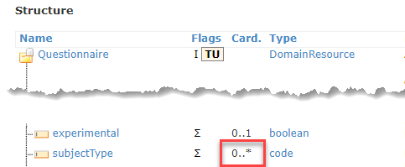
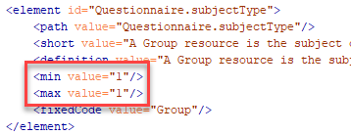
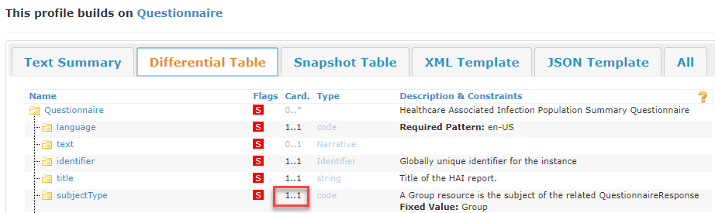
Cardinality
Base Questionnaire resource with zero to many [0..*] subjectType allowed.
StructureDefinition for a profile on Questionnaire – constrains cardinality on subjectType to exactly one [1..1].
Resulting profile in an IG showing constrained cardinality on subjectType.

Slide 42
Terminology Binding
Codes that are allowed for a coded element
Bindings:
Fixed
Single code/system, everything not specified is prohibited (e.g. display is prohibited if not specifically fixed)
Pattern
Single code/system, everything not specified is allowed (e.g. display is allowed to be any value if it is not specifically fixed)
ValueSet
Bind to a ValueSet resource (a list of codes that can be validated)
Binding Strength
Options: required, extensible, preferred, or example

Slide 43
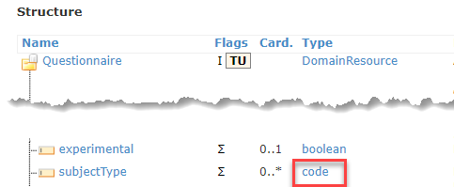
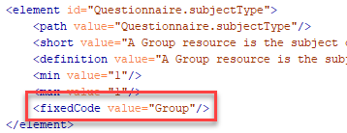
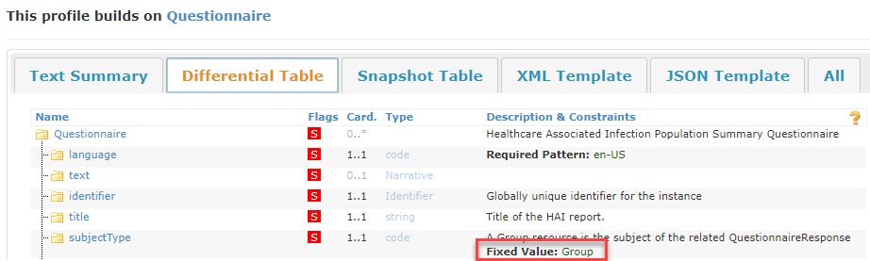
Terminology - Fixed
Base Questionnaire coded element but no terminology specified
StructureDefinition for a profile on Questionnaire – constrains terminology to be a fixed value of “Group”.
Resulting profile in an IG showing constrained terminology on subjectType.

Slide 44
ValueSet binding strength
Binding Strengths
Required – must use a value from specified value set – can’t use any other values
Extensible – if a code for the required concept exists in the value set it must be used – otherwise can use another value
Preferred – recommended (but not required) value set
Example – example value set – not expected to use these values

Slide 45
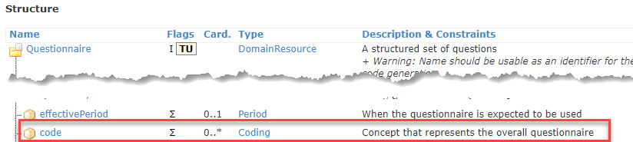
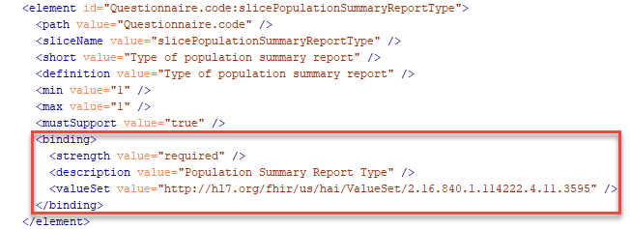
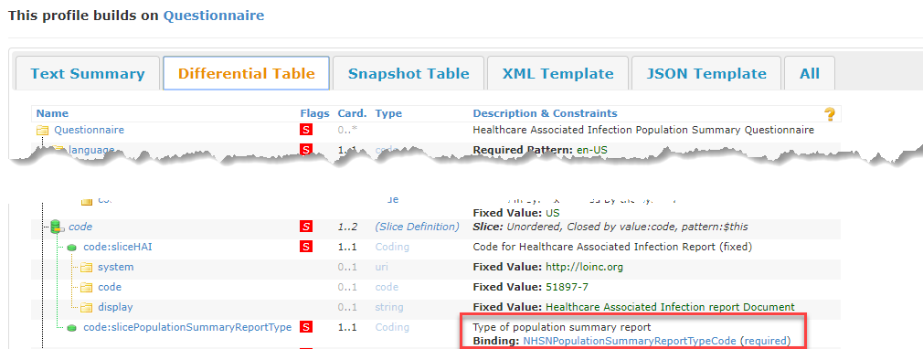
Terminology – Value Sets
Base Questionnaire coded element but no terminology specified
StructureDefinition for a profile on Questionnaire – constrains terminology to a specific value set. Strength of binding is “required” (SHALL use a value from this value set).
Resulting profile in an IG showing constrained terminology on code slice.

Slide 46
Slicing
Take an element that may occur more than once (e.g. in a list), and then split the list into a series of sub-lists, each with different restrictions
Classic example is a blood pressure observation where there are two components – systolic and diastolic
Each component is a “slice”
Each slice has a different, fixed LOINC code to differentiate it from any other component – “systolic” and “diastolic”
A discriminator identifies the slice

Slide 47
Slicing - Discriminator
A discriminator identifies the slice – this is what the system checks to distinguish between multiple slices
Discriminator types:
Value
Exists
Pattern
Type
Profile
Blood pressure example would be “Value” – the system would check the value of the element for “systolic” or “diastolic”

Slide 48
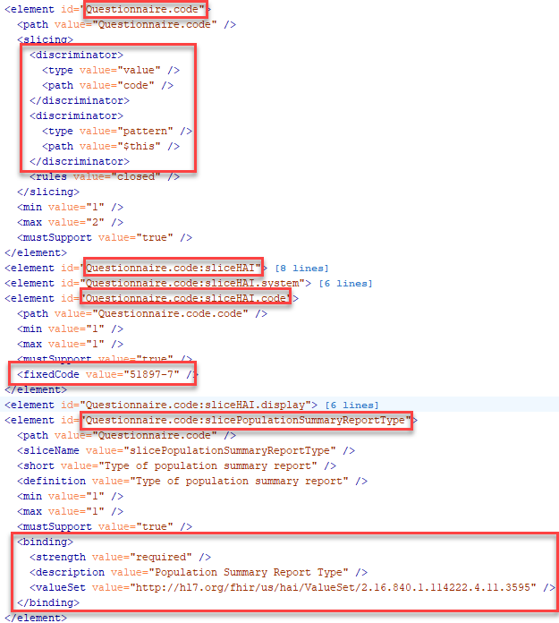
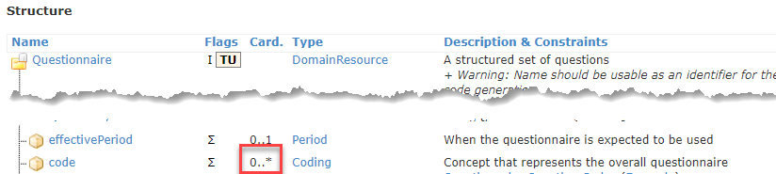
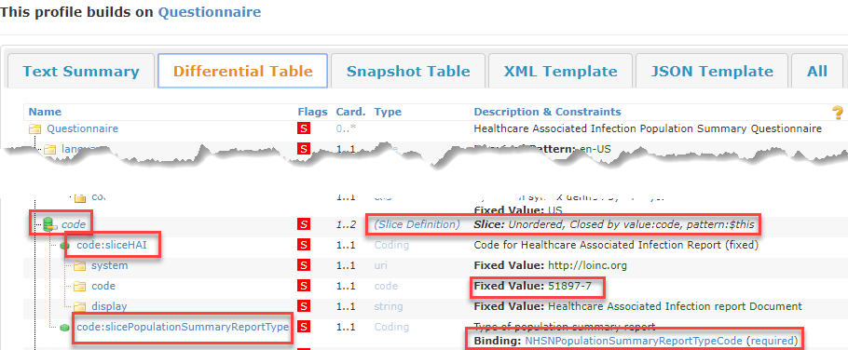
Slicing
Base Questionnaire.code element – multiple allowed
StructureDefinition for a profile on Questionnaire – setting up slicing on Questionnaire.code
Resulting profile in an IG showing slices and discriminators set up on Questionnaire.code

Slide 49
Must Support
Implementers SHALL provide "support" for the element in some meaningful way
Often used for items that we want to require, but for which data sometimes does not exist (e.g. allergies)

Slide 50
StructureDefinition Resource
StructureDefinition Resource the definition of a FHIR structure
Used to define base FHIR resources, data types, extensions, etc.
Describes a structure – a set of data element definitions, and their associated rules of usage

Slide 51
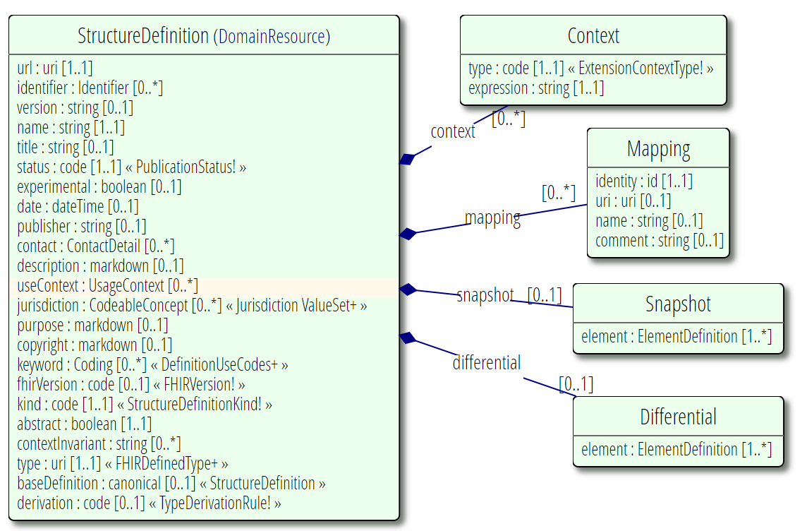
StructureDefinition UML Diagram

Slide 52
Important StructureDefinition Fields
url: Canonical identifier for this structure definition, represented as a URI (globally unique)
name: Name for the structure definition. Should start with a capital and should not contain spaces or special characters (can contain underscores but not dashes). E.g.: “Test_Profile”
title: A short, descriptive, user-friendly title for the structure definition. E.g.: “Test Profile”
description: A free text natural language description of the structure definition from a consumer's perspective.
fhirVersion: The version of the FHIR specification on which this StructureDefinition is based. (e.g. 4.0.0)
type: The resource or datatype constrained by this StructureDefiniton (e.g. “Observation” or “Questionnaire” or “Condition”)
baseDefinition: the base structure from which this one is derived (e.g. http://hl7.org/fhir/StructureDefinition/Condition or http://hl7.org/fhir/us/core/StructureDefinition/us-core-condition )
snapshot: Created automatically by tooling. Defines the “roll up” of all constraints from this profile and any base profiles and resources.
differential: If present, contains one or more ElementDefinition types describing differences from the baseDefinition

Slide 53
StructureDefinition.element
The Snapshot and Differential contain the definition of the structure being defined
Made up of multiple “element” data elements
ElementDefinition data type
includes:
Path (name), Cardinality, and data type
Definitions, usage notes, and requirements
Default or fixed values
Constraints, Length limits, and other usage rules
Terminology Binding
Mappings to other specifications
Structural Usage Information such as Slicing

Slide 54
StructureDefinition.element
StructureDefinition.element (type=ElementDefinition) – important fields:
path: path of the element in the hierarchy (e.g. Communication.topic)
sliceName: name for this particular slice (in a set of slices)
slicing: declares that this element will be sliced and contains the slicing information
short: a short description of the element
definition: the full description of the element
min: the minimum cardinality of the element
max: the maximum cardinality of the element
type: the datatype, resource, or profile of the element
fixed: value must be exactly this
pattern: value of the element must have at least these property values
mustSupport: if the element must be supported
binding: value set binding, if this element is coded

Slide 55
US Core Patient
Live walkthrough of US Core Patient: https://www.hl7.org/fhir/us/core/StructureDefinition-us-core-patient.html

Slide 56
Extensions
FHIR Principle of 80/20
Base specification includes resources and data elements for most common requirements across use cases
Any specific requirements unique to an use case have to be addressed using extensions

Slide 57
Extension Structure

Slide 58
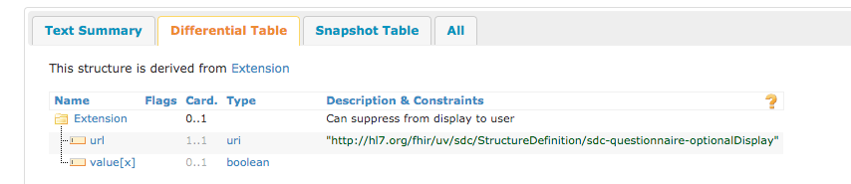
Simple Extension Example
Simple Extension
A single URL defining the extension and a single value within the extension
http://build.fhir.org/ig/HL7/sdc/extension-sdc-questionnaire-optionalDisplay.html

Slide 59
Exercise: Creating Extensions
Simple Extension
Open questionnaire-sdc-profile-spreadsheet.xml in Excel
Goto Extensions tab
Look at the example we reviewed
OptionalDisplay
Ask Questions
Create a new extension
Add to sdc.xml
Publish IG and review content

Slide 60
Extensions Cont’d
Complex Extension
Single URL defining the extension and multiple values using nested extension elements
http://build.fhir.org/ig/HL7/sdc/extension-sdc-questionnaire-launchContext.html
Review the complex extension example

Slide 61
Exercise: Adding Extensions in Profiles
Open questionnaire-sdc-profile-spreadsheet.xml in Excel
Goto sdc-questionnaire-render tab
Look at the extensions on Questionnaire, Questionnaire.item
Add an extension to sdc-questionnaire-item and publish the IG and look at the profile rendered locally

Slide 62
Capability Statements
A Capability Statement documents a set of capabilities (behaviors) of a FHIR Server for a particular version of FHIR that may be used as a statement of actual server functionality or a statement of required or desired server implementation.
Uses
Determining what capabilities are supported by an implemented FHIR Server (e.g Resources, versions, security aspects, search parameters etc)
Used to specify conformance requirements for FHIR implementations (This aspect of Capability Statement is used in Igs)
Used for conformance testing, interface mechanisms, methods etc.

Slide 63
Example: IG Capability Statements
Example Walk through
http://build.fhir.org/ig/HL7/sdc/sdc-form-manager.html
Review the above example with both XML version and the HTML version

Slide 64
Exercise: IG Capability Statements
To the following capability statement
http://build.fhir.org/ig/HL7/sdc/sdc-form-manager.html
Add sdc-questionnaireresponse profile to be supported by the Form Manager system

Slide 65
What is a CodeSystem
“The CodeSystem resource is used to declare the existence of a code system, and its key properties:”
Identifying URL and version (if needed)
Description, Copyright, publication date, and other metadata (as appropriate)
In addition, the CodeSystem resource may list some or all of the concepts in the code system, along with their properties and designations.

Slide 66
Review CodeSystem Example
http://build.fhir.org/ig/HL7/sdc/launchContext.html
Open the codesystem-launchContext.xml file
Review and walkthrough the example

Slide 67
Exercise: Code Systems
Create a new CodeSystem that captures QuestionnaireUsagePurpose to contain the concepts
Research – capturing data for research
pro – capturing Patient Reported Outcomes
Case-reporting – Case Reporting from clinical care
Surveys – Use for patient surveys
Registration – use for registration of patients
data-collection – for all other data collection activities
Add the codesystem to the build in sdc.xml and publish

Slide 68
Value Sets
List of concepts drawn from a CodeSystem used for a specific purpose
Could contain one or some or all of the concepts
Discussion on Bindings and Binding Strengths
http://hl7.org/fhir/R4/terminologies.html
Required
Extensible
Preferred
Example

Slide 69
Example Value Set
In SDC project Examples Folder
Open valueset-sdc-profile-example.xml
Review and Walkthrough the example

Slide 70
Exercise: Value Sets
Create a new value set called researchdatacollection
Use the newly created CodeSystem: QuestionnaireUsagePurpose
If you did not create it successfully, choose any CodeSystem of choice and select concepts.
Select the concepts
Research
Data-collection
Add to IG in sdc.xml and publish it.

Slide 71
Adding Narratives for Profiles and Extensions
Narrative PageContent is present in the pagecontent folder as XHTML files
Structure Definition Intro and Notes
*intro.xml
Adds content at the top of the HTML Page
*notes.xml
Adds content at the bottom of the HTML Page
Adding other content such as index.html, overview.html
Amounts to creating the content in XHTML and putting it in the pagecontent folder and updating the ig.xml (sdc.xml) file

Slide 72
Exercise: Narratives
Add a new page called test.xml with some sample content.
Add some paragraphs and heading etc.
Add this to ig.xml and publish and review and discuss
Add sdc-test-questionnaire-intro.xml and sdc-test-questionnaire-notes.xml
Re-Publish and verify

Slide 73
Exercise: Embedding Images in IGs and Narratives
Adding Images
Add an image of your favorite choice to test.xml usng XHTML tags
Publish the IG and review

Slide 74
Images Exercise
Using Markdown
How does it work
Example
Using XHTML
How does it work
Example

Slide 75
Examples: Adding Examples
Adding Examples for profiles
Create examples using the Resource structure conformant to the profile definition
Questionnaireresponse-sdc-profile-example.xml
Create examples using a Bundle Resource with multiple entries
Each entry showing a different variation of the profile
Questionnaire-sdc-profile-example.xml

Slide 76
Examples - Exercise
Add Example for a profile
Copy an entry from the Questionnaire-sdc-profile-example.xml into a new file
Modify content
Add the example into the sdc.xml and publish the ig and review

Slide 77
Validator
Find full documentation here: https://wiki.hl7.org/index.php?title=Using_the_FHIR_Validator
Using Validator as part of the IG build
Binding the XML files to specific schemas will validate the structure against the schema.
Example:
Questionnaire-sdc-profile-example.xml

Slide 78
Validator Cont’d
Validation pack (NPM Package)
Can be used by clients and servers to check conformance to specific profiles outlined in the IG
Can be used to validate against published code systems and value sets.

Slide 79
FHIR Implementation Guide Creation Training
Day Two

Slide 80
Questions?
You’ve had some time to think

Slide 81
FHIR Publishing Process
Process is Important

Slide 82
Topics
Project Scope Statement (PSS)
Implementation Guide proposals
Publication checklist
Using Zulip and WG Calls

Slide 83
HL7 Processes
Some of the process steps may be managed by WG Co-Chairs or by a Project Manager
But you should be aware of the processes at least at a high level

Slide 84
Confluence Pages and Checklist
A set of Confluence pages have been set up to provide guidance on FHIR IG processes
https://confluence.hl7.org/display/HL7/FHIR+Implementation+Guide+Process+Flow
Walk through each process, relevant steps and dependencies
Include links to relevant documents and forms

Slide 85
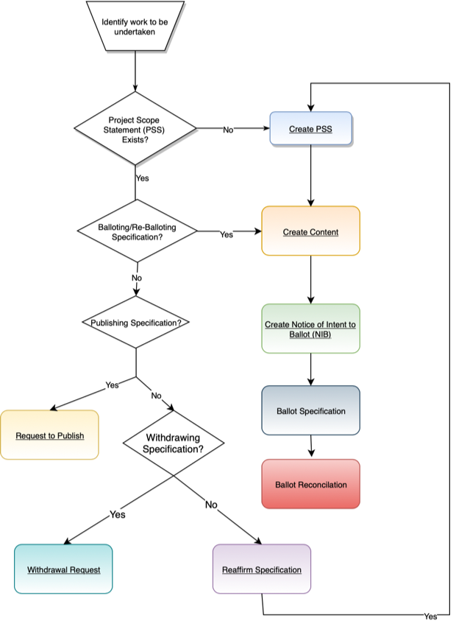
FHIR IG Process Flow
https://confluence.hl7.org/display/HL7/FHIR+Implementation+Guide+Process+Flow
There are some FHIR specific requirements to be aware of

Slide 86
Calendars
HL7 Calendars
https://confluence.hl7.org/display/HL7/HL7+Calendars
FHIR specific dates
https://confluence.hl7.org/display/HL7/HL7+FHIR-specific+dates

Slide 87
Process Steps
WG Approvals of PSS
Notice of Intent to Ballot (NIB)
Harmonization
Initial content
Ballot reconciliation deadline
Final content deadline
Ballot Readiness Sign-off

Slide 88
FHIR Specific Steps
FHIR IG Proposals Due
FHIR IG substantially complete
FHIR ballot core substantive freeze
FHIR QA Deadline
FHIR Final QA Deadline
FHIR Connectathon Proposals Due

Slide 89
Appeal Deadlines
Appeal process through Technical Steering Committee (TSC) if dates are missed
Missed NIB deadline
Missed initial content deadline
Missed final content deadline

Slide 90
Project Scope Statements (PSS)
Project Scope Statements
Mechanism to communicate the activity being undertaken
Must provide sufficient information to allow inexperienced individuals to anticipate what a WG is working on and decide if they wish to become involved
Also the mechanisms for WGs to manage the work
https://confluence.hl7.org/display/HL7/A+-+Project+Scope+Statement

Slide 91
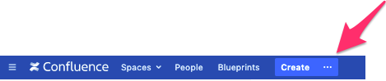
PSS
Previously submitted via a Word Document, now using Confluence
PSS Help and FAQs: https://confluence.hl7.org/display/PSS/PSS+Help+and+FAQs
Confluence
Click “Create …”
Search for “Project” and select “HL7 Project Scope Statement Form”

Slide 92
PSS – Key Requirements and Approvals
Used for work underway in HL7 - to be balloted/published by HL7
Must be approved by a sponsoring Work Group
May have co-sponsoring Work Group(s) – must be approved by all
If US Realm, must be approved by the US Realm Steering Committee
Forward to tscpm@HL7.org
FHIR IG – must be approved by FHIR Management Group (FMG)
Forward to fmgcontact@hl7.org
Must be submitted to Project Management Office (PMO)
Forward to pmo@hl7.org
Must be approved by Steering Division (SD) of sponsoring Work Group
Must be approved by Technical Steering Committee (TSC)
This is handled by SD Co-Chairs once approved in the SD
Deadline for approval for PSS for the next cycle
4 weeks before the WGM (e.g. deadline for PSS for Feb 2020 Ballot cycle was 2019-08-16)
May 2020 Ballot Cycle - 2019-11-17

Slide 93
Implementation Guide (IG) Proposal
FMG requires the submission of an IG Proposal
Template: https://wiki.hl7.org/Template:FHIR_IG_Proposal
Must be submitted to FMG at least 3 weeks prior to the NIB (Notice of Intent to Ballot) deadline
Must be approved by FMG by the NIB deadline

Slide 94
Notice of Intent to Ballot (NIB)
NIBS – submitted by WG Co-Chair
Links:
http://www.hl7.org/special/committees/tsc/specialuploads/NIB_Instructions.pdf
Current Cycle NIBs

Slide 95
NIB – Key Requirements and Approvals
Content of IG must be at FMM level 2 (if balloting as STU) or FMM level 5 (Normative) prior to submission of NIB
IG Proposal must be approved by FMG before NIB submitted
PSS must be submitted to PMO
Content must be substantively complete
Not focused on actual content, but rather:
All artifact types must be defined and working
Any complexity must be identified
Structures and inheritance must be defined
Tooling issues identified
If anything introduced after this that breaks IG build, will not be fixed

Slide 96
Ballot/Publication Readiness Checklist
Content of IG must be at FMM level 2 (if publishing as STU) or FMM level 5 (Normative) prior to submission of publication request (or exception has been received from FMG
Ballot reconciliation for previous ballot
Must be complete before going to ballot again or publication
For January 2020 Ballot cycle: Deadline is 2019-12-08

Slide 97
Ballot/Publication Readiness Checklist
FHIR QA deadline – 2 weeks before final content deadline
The IG must be totally complete
Sponsoring WG must approve content
may identify quality issues with it that can then be fixed
FMG approval
May be reviewed by the FMG who will check that it is "sufficiently complete to be ready for ballot" - which for STU means that it looks fully implementable and that there aren't missing pieces.
It's not kosher to have the IG 'mostly' complete and expect to fix outstanding issues during the QA period.
If the IG author wishes, they can approach the relevant work group(s) and see if they're willing to accept a shorter review period. The shortest possible review period permitted would be start in one week. If all relevant work groups accept a later date, the QA deadline becomes the earliest of the deadlines the work group(s) accept or one week from this deadline.

Slide 98
Ballot/Publication Readiness Checklist
Co-sponsoring WGs must approve content
FHIR IG’s must meet IG quality criteria
https://confluence.hl7.org/display/HL7/3.+FHIR+IG+Quality+Criteria
Prior to ballot or publication, readiness checklist must be completed and submitted
Checklist confirms that each of the requirements has been met

Slide 99
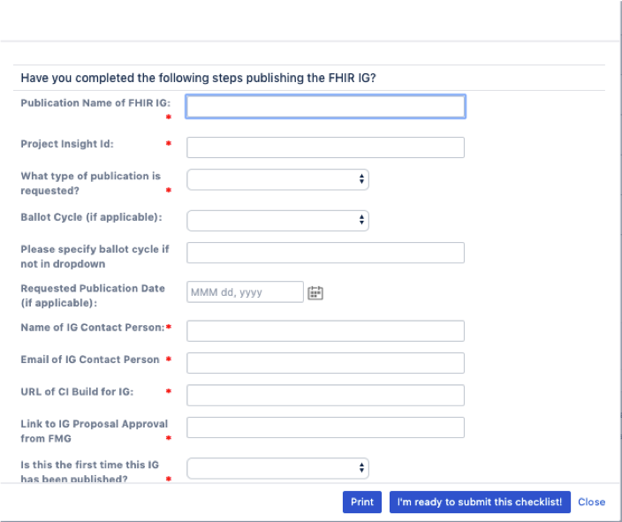
Checklist
Some of the content for the checklist were specified in the IG proposal

Slide 100
Common Issues with FHIR IGs
Correct (new) HL7 logo
Publisher ("HL7 International - <workgroup full name>" and contact)
History page listing all other releases
Realm issues
Version issues – All the versions matching across artifacts

Slide 101
Common Issues with FHIR IGs
Header and Footer information
Everything is included
Publish box
Missing downloadable zip file containing the full content of the IG

Slide 102
Monitoring during Ballot Cycle
Status of IG’s in current ballot cycle is monitored by FHIR Ballot Facilitator
Emails are sent out to developer to obtain information and as reminders through out ballot cycle
Starting after NIB deadline
Purpose is to support
Developers
Meet requirements
Meet deadlines and other criteria
FMG
in monitoring IG development

Slide 103
Using Zulip
http://chat.fhir.org
Relevant streams to subscribe to:
IG Creation
https://chat.fhir.org/#narrow/stream/179252-IG-creation
Implementers
https://chat.fhir.org/#narrow/stream/179166-implementers

Slide 104
Using Calls
Review and approval by Work Groups
Make sure you are aware of the sponsoring and co-sponsoring Work Groups
For review of final content during QA period
Submit material to WG Co-Chair(s)
Schedule time on WG teleconference to review content and seek approval
Approval must be in WG minutes

Slide 105
Community Building
It’s not just about the code

Slide 106
Building Community
Building a FHIR IG isn’t just about creating the profiles and text, it has to solve a problem in a way that works. Even if it is technically perfect, it can still be wrong if it doesn’t solve the needs of the community in a way they can use it.
All stakeholders, not just the sponsors, need to be part of the community and need to be heard.
Sponsors are a good link to appropriate groups that will be a part of your community

Slide 107
Building a community
Your FHIR IG’s community can be huge or small, depending on the use case.
Find the stakeholders and get them involved though meetings, surveys, email, any form of communication.
Facilitated meetings are the best way to get all issues on the table and move the process forward.
Find out key requirements versus needs versus nice-to-haves
What needs to be profiled versus what needs to be documented
What is urgent versus what’s considered for future use

Slide 108
Zulip – chat.fhir.org
If you haven’t signed up, do it now. We’ll wait.
Join the #IG Creation, #committers/notification and which ever others hold your interest (hint, hint, #committers/git-help)
Answers to your issues and identifying “undocumented features” of the toolset that arose from Grahame’s last commit can be found there.
Often the exact issue that you’re facing is or has been found and/or solved by someone there.
Don’t be afraid to ask stupid questions, people there are able to help.
Also, many members of your community are there. There are roughly 100 channels already and you can make one if you haven’t found yours.

Slide 109
Working with HL7 Work Groups
One of the ways to build a community is through the appropriate work groups.
Work groups are a representation of those who work with and in a specific community and/or subject area.
a great source for subject matter experts, process experts and representatives of your community
can review your use case, documentation, content problem solving ideas
can also throw needless roadblocks if they don’t understand your use case and/or have an agenda.
Using the mailing list or getting your IG on the meeting agenda for a teleconference.

Slide 110
The Author’s Role
The IG Author(s) will be seen as the experts in what can be done and how to make it all happen.
Nail down the scope of the IG as tightly as possible at the start.
The Author(s) need to make the process smooth by helping to facilitate discussions on the possible, impractical and impossible and correctly label each.
ASK QUESTIONS but phrase them carefully.
Offer alternatives to the impractical and impossible, refine the possible
If the author doesn’t understand it, then it’s going to be done wrong.
ASK QUESTIONS but phrase them carefully.

Slide 111
Getting to Yes, or No
The biggest problem in building a use case solution is limiting what needs to be done. That means prioritizing and sometimes saying “No”. But only sometimes
Easy “No”s are that which is technically impossible. Everything else is negotiable
Is that request urgent, needed or nice to have?
Is that needed now, or can we worry about that in the future
Can we put a note in the documentation instead of constraining it?

Slide 112
It’s All About Time
Prioritization is also about setting and meeting timelines. A four-year project to create version 1 of an IG is a waste of life.
What’s a reasonable timeline? – How big is it?
How many profiles, extensions, codesets, examples? How much can be re-used/borrowed?
How much research?

Slide 113
It’s All About Time
What’s a reasonable timeline? – How big is it? (cont’d)
How much explanatory text?
How many diagrams?
All of this takes time. All of this takes resources to create.
Authors , modellers, SMEs, reviewers, vocabulary, etc.

Slide 114
Use of Connectathons
“An HL7 [FHIR]Connectathon is a two-day event of hands-on FHIR development and testing held in conjunction with Working Group Meetings.”
Once you have a working prototype, the FHIR Connectathon is the best way to put it in front of parts of the community and see where the holes are.
Find a/some member(s) of the community who can be partners for the test
New issues, other points of view, new eyes on a tricky issue all become more apparent than working in isolation

Slide 115
Comment Ballots
With a Connectathon test achieved, and the issues cleared up, it’s time to let the whole community have a look.
Submit a Notice of Intent to Ballot and go through the publication readiness checklist to get all the supporting paperwork done
Package-list.json
Properties.txt
A perfectly clean (or at least only issues for Grahame left) QA result
A fresh, clean IG is then pushed to the HL7 FHIR repository.

Slide 116
Comment Ballots
Invite as many as possible to review the IG as in depth as possible and submit detailed comments
Sit and watch as the community calls your baby ugly.
Comments come in three flavours:
Typo – tend to be automatically accepted
Affirmative – suggestions, questions or comments that the commenter feels would improve or clarify the content
Negative – changes the commenter feels must be made to make the IG suitable for use.

Slide 117
Comment Resolution
In-person resolution at the following WGM is best. However, discuss prior with negative commenters with negotiated solutions
Follow the easy-to-use steps to get all your ballot comments into GForge (or, someday, Jira):
Review all comments and, with the project team, create suggested dispositions (solutions) for each.
Suggested dispositions are suggestions. They might not be what the commenter wants so some negotiation is needed.
“Not Persuasive” should be used only when the comment is impossible. Otherwise, find a negotiated solution. That may include “Considered for Future Use”
Affirmative comments need only be considered, they do not require action.
Some comments may be enough to make your change your model (resource choices, etc.). That usually requires another comment ballot.

Slide 118
Source Control

Slide 119
Version Management
There are several versions you need to manage:
The FHIR version you’re using as your base
The version of your IG (less than 1.0 at the start)
(optionally) the version of IG you’re dependent on (USCore)
You don’t need to worry about the FHIR version, except to list it in your ImplementationGuide resource
USCore (if you’re dependent) has different versions based on FHIR version and may be revised. It’s important that you track it’s version as it may break your build with a change if you’re working from the CI version.

Slide 120
Version Management
Your IG’s version is dependent only on your development. Typically, you’ll use 0.1.0 as your development and initial comment period version, specifying that you’re in-progress and things are ready to change.
Your second comment ballot version is 0.2.0, and so on.
When you’ve done all your balloting and comment resolution, then you hit version 1.0 for STU 1
When you update it for STU 2, or beyond, you’re at 2.0, etc.
Revisions for STU updates are 1.1, etc.

Slide 121
The FHIR Maturity Model (FMM)
FMM1 = no warnings during the build process and the responsible WG has indicated that they consider the artifact substantially complete and ready for implementation.
The FHIR Management Group has approved the underlying IG proposal.
FMM2 = tested (e.g. at a Connectathon) successfully among at least three independently developed systems using semi-realistic data and scenarios
FMM3 = verified by the work group as meeting the Conformance Resource Quality Guidelines;
has been subject to a round of formal balloting
at least 10 distinct implementer comments from at least 3 organizations resulting in at least one substantive change

Slide 122
The FHIR Maturity Model (FMM)
FMM4 = tested across its scope, published in a formal publication (e.g. STU), and implemented in multiple prototype projects.
the responsible work group agrees the IG is sufficiently stable to require implementer consultation for subsequent non-backward compatible changes.
FMM5 = the artifact has been published in two formal publication release cycles at STU level and has been implemented in at least 5 independent production systems (in multiple countries if not US Realm)
FMM6 = the responsible work group and the FMG agree the material is ready to lock down and the artifact has passed HL7 normative ballot

Slide 123
GitHub
Please sign up for GitHub and let the FMG know your GitHub username so you can work in the FHIR space
To do this, just send a message to the "GitHub Usernames" stream of #committers listing your username
Download and install a Git client for your operating system
Check in (“Push”) your current code base

Slide 124
GitHub Issues
Working with Git is a challenge at times, if you have multiple committers. If you do need to have multiple people working on the project, there are two ways to handle this.
You have sole committer access, people send you the files they are adding, you review and push them into the build.
You maintain branches and merge manually
Some think one is best as you don’t end up (frequently) with mystery breakages due to uncommunicated changes.
Using Git/GitHub version control allows you to roll back changes that break your build or were committed accidentally.
Always pull the latest version of the code base before branching if you’re working with multiple developers.

Slide 125
Setting Up the CI Build Process
Create an IG in a new GitHub folder, including a file called ig.json containing the IG definition, alongside any other content that your IG requires.
Configure the Webhook (next slide)
Now GitHub will automatically trigger a build whenever you commit changes.
It can take 2-3 minutes for the build and you will see a notification in Zulip in committers/notifications/ig-build
https://fhir.github.io/auto-ig-builder/builds.html shows the status of all IG CI builds and allows triggering a re-build.

Slide 126
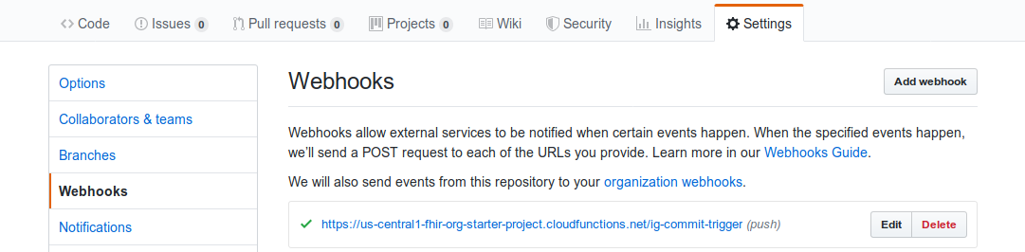
Adding the Webhook
Add a Webhook in GitHub: click "Settings", then "Webhooks", then "Add Webhook".
Enter the URL: https://us-central1-fhir-org-starter-project.cloudfunctions.net/ig-commit-trigger.
Choose "Content type" of application/json
Accept the default (empty) "secret".
Choose "Just the push event" as the trigger,
Click "Add webhook".
1
3
2

Slide 127
Vocabulary

Slide 128
Internal vs. External Code Systems
FHIR Code systems define the codes used for standard value sets used in the Profiles
External such as RxNorm, SNOMED, LOINC, etc.
FHIR Internal (FHIR Created) all prefixed with http://hl7.org/fhir/
FHIR External (FHIR licensed or imported) all prefixed with http://terminology.hl7​.org/CodeSystem/
HL7 V3 using http://terminology.hl7.org/CodeSystem/v3-[Name]
HL7 V2 using http://terminology.hl7.org/CodeSystem/v2/[Table]
Where possible, using HL7 code systems simplifies matters but may not cover your use case.
For a full list: https://www.hl7.org/fhir/terminologies-systems.html

Slide 129
A reminder!
Always check to see if there is a code system or value set that meets your needs before creating your own.
Extend it or constrain as necessary

Slide 130
Using SNOMED CT with FHIR
SNOMED CT has two common sets of implicit value sets defined: By Subsumption, by Reference Set. Implicit value sets can also be defined using an expression constraint.
The implicit value set capability allows a single URL to serve as a value set definition and can serve as the basis for value set references.
If any value set resources exist with an identifier that conforms to URL patterns, the content of the resource must conform to the template provided. Profiles and other value set references can reference these value sets directly (by reference as a URI, rather than by a literal value set reference).
A SNOMED CT implicit value set URL has two parts:
The base URL is either http://snomed.info/sct , or the URI for the edition version, in the format specified by SNOMED International in the SNOMED CT URI Specification
A query portion that specifies the scope of the content

Slide 131
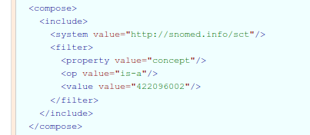
Subsumption
Includes all concept ids that have a transitive is-a relationship with the concept id provided as the value (including the concept itself)
For example: the Administration Methods subsuption is where concept is-a 422096002 (Dosing instruction fragment)
https://www.hl7.org/fhir/valueset-administration-method-codes.xml.html

Slide 132
By Reference Set
Includes all concept ids that are active members of the reference set identified by the concept id provided as the value
Syntax is the same except op value=“member of”

Slide 133
Using SNOMED CT with FHIR
The URL http://snomed.info/sct should be understood to mean an unspecified edition/version.
If no version or edition is specified, the terminology service SHALL use the latest version available for its default edition (or the International Edition, if no other edition is the default).
The recommended string template to use for a version (substituting in the appropriate module for {sctid} and {effective time}) is http://snomed.info/sct/{sctid}/version/{timestamp}
More information is at: https://www.hl7.org/fhir/snomedct-usage.html
Please note: don’t bind (meaning use extensible, required, etc.) if your IG is in the international domain. While countries like the US and Canada have a free license, many countries, in the EU and beyond do not.

Slide 134
SNOMED URIs
The URIs that identify (unversioned) Editions and Versions (i.e., versioned Editions) take the following respective forms:
http://snomed.info/sct/{sctid}
http://snomed.info/sct/{sctid}/version/{timestamp}
The SNOMED CT URI Guide contains additional discussion and guidance on this topic.
Search for the code(s) you need using the SNOMED browser (https://browser.ihtsdotools.org/ )
Examples
SNOMED CT International Edition http://snomed.info/sct/900000000000207008
SNOMED CT International Edition, 20130731 http://snomed.info/sct/900000000000207008/version/20130731
SNOMED CT-AU http://snomed.info/sct/32506021000036107
SNOMED CT-SE http://snomed.info/sct/45991000052106

Slide 135
Using LOINC with FHIR
The terms of use for LOINC require that a notice be included with any use of LOINC codes in the copyright element of the value set.
The URI http://loinc.org identifies LOINC codes
LOINC also allocates Answer List and Answer String Ids for use in forms and Questionnaires.
More information is at https://www.hl7.org/fhir/loinc.html
The LOINC browser is at https://search.loinc.org/ to find a code you need

Slide 136
LOINC Codes
LOINC Parts are a coded representation of a value for a dimension used to specify a LOINC Term which are assigned a non-semantic identifier with a "LP" prefix and a mod-10 check digit (e.g. LP31755-9). Following the LOINC license, these part codes may be used in the following ways:
In filter properties,
In Structure Definitions, where the structure describes the use of a set of LOINC codes
In a ConceptMap resource, where mappings between LOINC codes and other codes are being defined

Slide 137
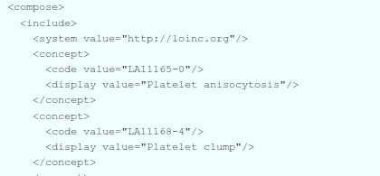
LOINC use in Questionnaires
LOINC allocates Answer List and Answer String Ids for use in various forms and questionnaires. LOINC Answer String IDs are also valid LOINC codes:
LOINC Answer List Ids are value set identifiers.

Slide 138
LOINC Properties
In addition to the standard properties, the following LOINC table fields are defined as code system properties when using LOINC in FHIR:
STATUS | string | Status of the term
COMPONENT | code | First major axis-component or analyte: Analyte Name, Analyte sub-class, Challenge
PROPERTY | code | Second major axis-property observed: Kind of Property (also called kind of quantity)
TIME_ASPCT | code | Third major axis-timing of the measurement: Time Aspect (Point or moment in time vs. time interval)
SYSTEM | code | Fourth major axis-type of specimen or system: System (Sample) Type
SCALE_TYP | code | Fifth major axis-scale of measurement: Type of Scale
METHOD_TYP | code | Sixth major axis-method of measurement: Type of Method
CLASS | string | An arbitrary classification of the terms for grouping related observations together
CONSUMER_NAME | string | An experimental (beta) consumer friendly name for this item. The intent is to provide a test name that health care consumers will recognize; it will be similar to the names that might appear on a lab report
CLASSTYPE | string | 1=Laboratory class; 2=Clinical class; 3=Claims attachments; 4=Surveys
ORDER_OBS | string | Provides users with an idea of the intended use of the term by categorizing it as an order only, observation only, or both
DOCUMENT_SECTION | string | Classification of whether this LOINC code can be used a full document, a section of a document, or both

Slide 139
LOINC Filters
LOINC Property filter using the LIONC properties (uses = or regex operations)
Third Party Copyright allowing for use of the inclusion or exclusion of LOINC codes that include third party copyright notices (uses the = operation)
Multi-Axial Hierarchy using codes based on parent/child relationships (uses the = or in operations)

Slide 140
Respecting IP
Use of External Code Systems must follow the guidelines for copyright and other restrictions
It is NEVER okay to use values from a code system without permission and/or attribution.
Most external code system you need are already in FHIR
If you need a Code system and there is not a code system definition setup via FHIR or terminology.hl7.org and you can’t use it via OID (urn:oid=OID) then it’s time to contact the HL7 Terminology Authority

Slide 141
HL7 Terminology Authority
“Terminology Authority - is responsible for the creation, implementation, and management of HL7 processes involving external terminology management. These processes shall be influenced by input from the Vocabulary Work Group and existing HL7 terminology practices.
The activities of the HTA are intended to complement maintenance of terminology that is used by HL7 protocol specifications. HTA works through the TSC to implement processes or polices that impact Working Groups”

Slide 142
HL7 Terminology Authority New Code Systems
First, open a GForge ticket requesting that Code System be added. Assign the Reviewing Work Group to be Vocabulary
Submit the HL7 Terminology Authority – Content Request form to the HTA, who will provide guidance.
HTA will review content and get back to you if there are any concern - this could be a cyclic process.
The approved form with HTA approval can then be submitted with your harmonization proposal.
Work with the work group vocabulary facilitator if you have questions.

Slide 143
What’s a CodeSystem
“The CodeSystem resource is used to declare the existence of a code system, and its key properties:”
Identifying URL and version (if needed)
Description, Copyright, publication date, and other metadata (as appropriate)
Some key properties of the code system itself:
concept permanence, compositional grammar, if the codes that it defines are case sensitive
What filters can be used in a ValueSet that references it
What concept properties are defined by the code system

Slide 144
What’s a CodeSystem
In addition, the CodeSystem resource may list some or all of the concepts in the code system, along with their properties and designations.
Code System resources may also be used to define supplements, which extend an existing code system with additional designations and properties.

Slide 145
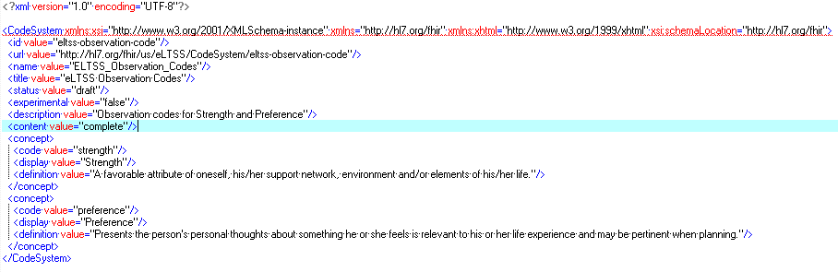
Code system definition example

Slide 146
Selecting ValueSet Concepts
Name the code system (with optional version if needed)
If including the code system, all codes are included by default
List specific codes from the system
With alternate descriptions, if needed
Select codes by property (‘filter’)
Property Name – defined by the code system
Operation – ‘=’, ‘is-a’, ‘in’, ‘regex’, etc.
Value – the value of the property
e.g., LOINC: COMPONENT = “Sodium”

Slide 147
ValueSet Concept Examples
Brings in all codes from the CodeSystem
<include>
<system value="http://hl7.org/fhir/us/core/CodeSystem/condition-category"/>
</include>
Includes only the specific code from the system you want
<include>
<system value="http://hl7.org/fhir/us/eLTSS/CodeSystem/eltss-condition-category-code"/>
<concept>
<code value="assessed-need"/>
<display value="Assessed Need"/>
</concept>
</include>

Slide 148
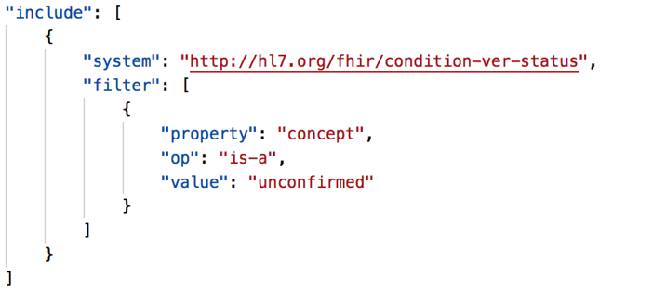
ValueSet Concept Examples
Uses a property filter to bring in all codes matching the value you specify

Slide 149
Creating your own ValueSet
As an Exercise, create a ValueSet for the Days of the Week
Constrain it to only have Monday through Friday, not including Wednesday as your use case is a physician that doesn’t work weekends and golfs on Wednesday.

Slide 150
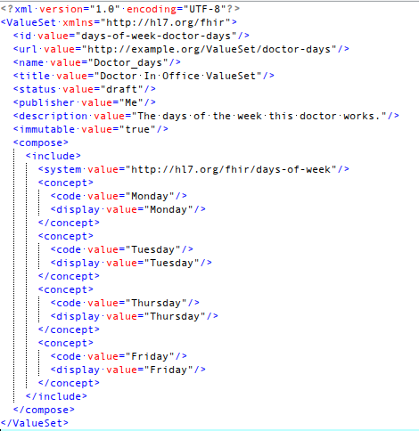
Exercise:
Don’t create a CodeSystem, FHIR already has one…
http://hl7.org/fhir/days-of-week

Slide 151
FHIR IG Quality

